Slide 1
Bank Customer Churn Analysis & Retention Strategies
Uncovering Key Drivers and Actionable Insights
- Arun Dara

Slide 2
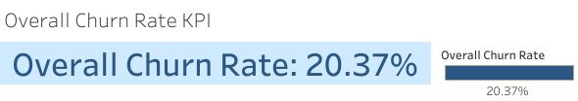
Nearly one in five customers are leaving, highlighting an urgent need for retention efforts.

Slide 3
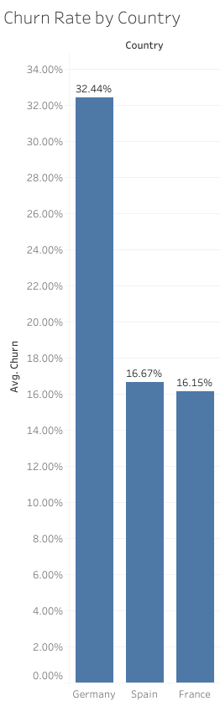
Churn rates vary significantly across different demographic segments.
Customers in Germany exhibit a substantially higher churn rate (32.44%) compared to France (16.15%) and Spain (16.67%).

Slide 4
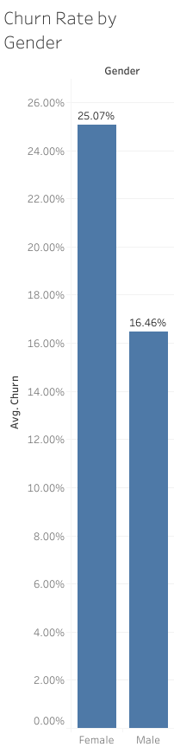
Female customers show a higher propensity to churn (25.07%) compared to male customers (16.46%).

Slide 5
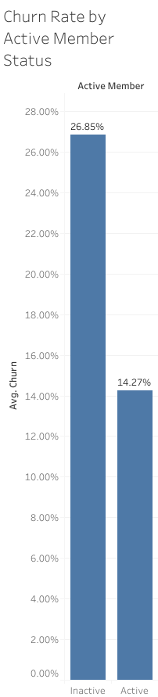
Membership activity is strongly associated with retention.
Being an active member nearly halves the churn rate compared to being inactive.
This suggests that initiatives to encourage engagement and keep members active could significantly reduce churn.

Slide 6
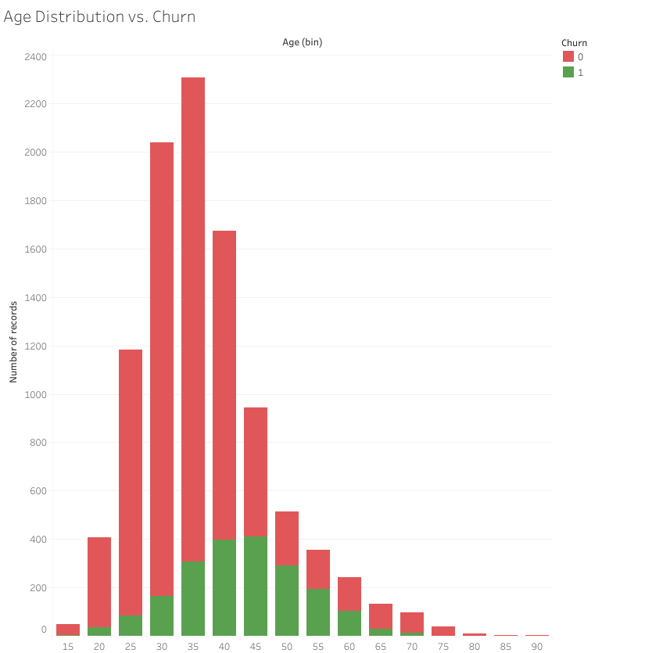
Customers maintaining zero account balances represent a significant portion of our churned base. This suggests either disengaged customers no longer utilizing our services or those actively seeking to close accounts.

Slide 7
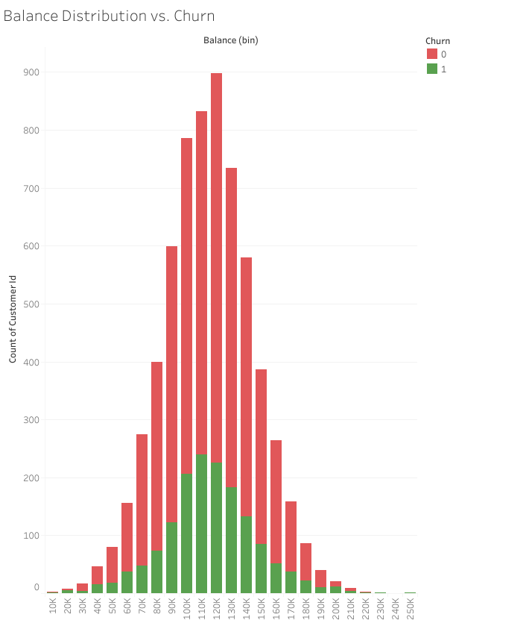
Most customers (churned and non-churned) have balances between ~70K and ~150K. Churned customers (green) are most concentrated in the 90K–130K balance range.
At very low and very high balances, churn is much less frequent.
Overall, the churn count appears to track the total customer distribution—i.e., churn is more common simply where more customers exist, rather than showing a clear pattern that higher or lower balances strongly drive churn.

Slide 8
